Slide 1

Bank Customer Churn Prediction
Mihir . M . Jade

Slide 2
Overview
This Bank Churn Prediction project aims to identify customers who are likely to leave the bank by analyzing their financial data. By predicting customer churn, the bank can take proactive measures to retain high-risk customers and overall customer satisfaction.
This project uses a dataset containing customer information such as credit score, geography, gender, age, tenure, balance, number of products held, and whether they have exited. The goal is to use machine learning algorithm to build a predictive model.

Slide 3
Problem Statement
Banks are struggling with high customer churn rates, leading to significant revenue losses. Understanding the factors driving customers to leave and predicting churn in advance can help mitigate the issue.
Use data of customers demographics and behaviours to predict which customers are likely to leave the bank, allowing to bank to take proactive measures to retain them.

Slide 4
Proposed Solution
Data Understanding: Analyze customer demographics, financial standing and engagement metrices such as credit score, balance and isActiveMember.
Data Preprocessing: Clean the dataset, handle missing values, and encode categorical variables like Geography and Gender into numerical form.
Machine Learning: Build a predictive model using algorithms like Logistic Regression, KNN, Decision Tree and Random Forest to determine customer churn.

Slide 5
Proposed Solution
Outcome: This model will help the bank identify at-risk customers and allow targeted interventions to reduce churn.

Slide 6
Descriptive Analysis
Dataset Information: The dataset includes 10,000 records and 14 features such as credit score, age, geography, balance, and number of products.
In the following slides are the observations which we have made from the data visualization done to understand the nature of the data available to us.

Slide 7
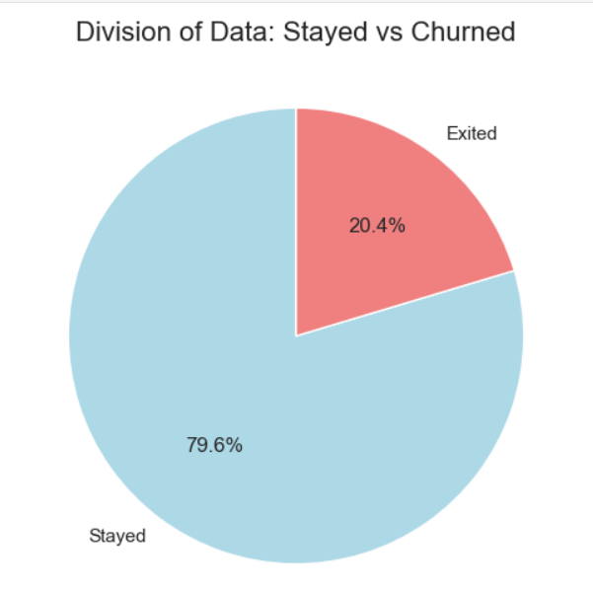
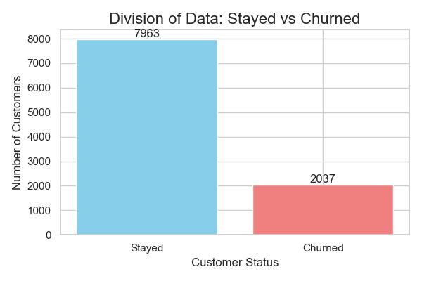
Descriptive Analysis
The data indicates that majority of customers (79.6%) chose to stay with bank. However, the 20.4% exit the bank.

Slide 8
Descriptive Analysis
Description | Stayed | Exited
Average Age | 37 | 44
Average Balance | 72,745 | 91,108
Average Credit Score | 651.85 | 645.35
Average Tenure | 5 | 4.9

Slide 9
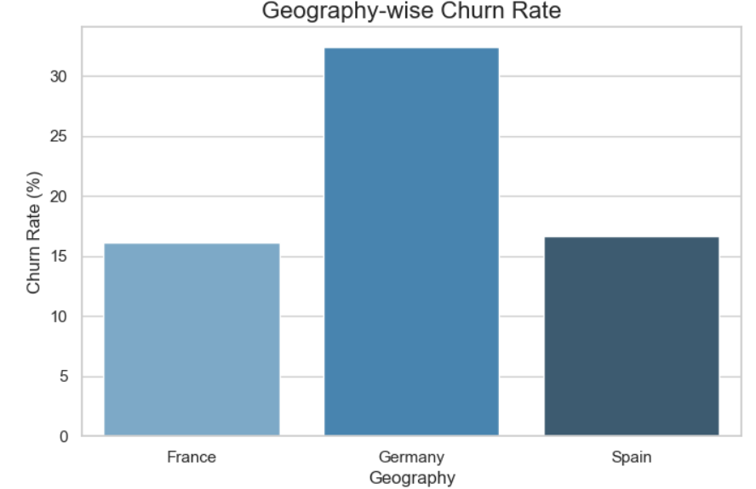
Descriptive Analysis
As we can see most customers are from Germany.
Spain and France and likely similar no. of customers.

Slide 10
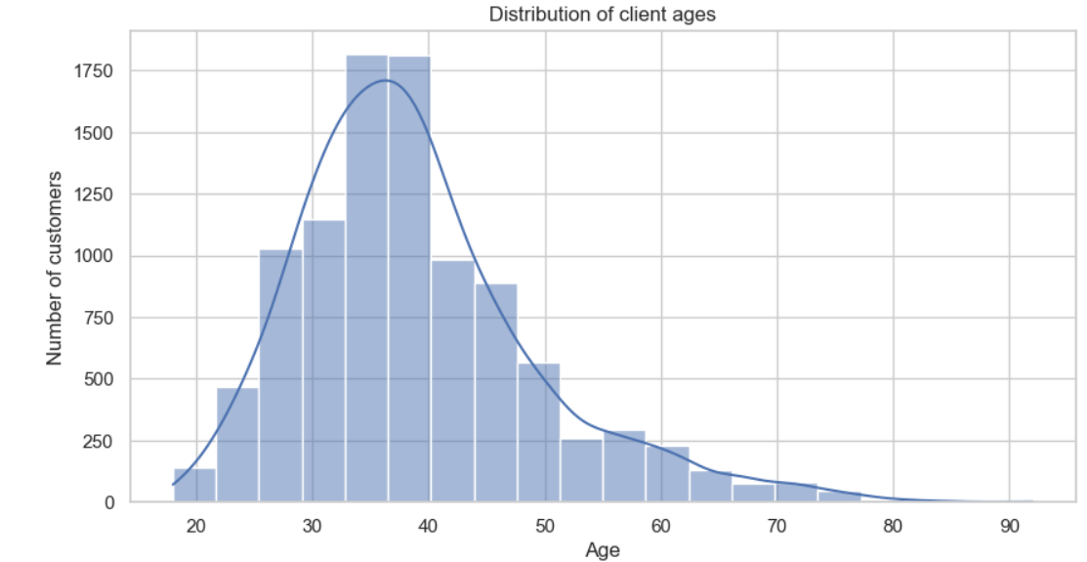
Descriptive Analysis
Most customers falls within the range 30 to 50 with highest peak at nearly 35.
After 60 there is very less no. of customers in bank.

Slide 11


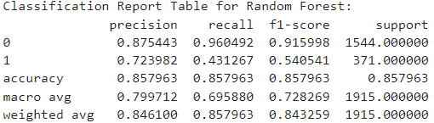
Machine Learning Modeling
Model | Accuracy
Logistic Regression | 81%
K-Nearest Neighbors | 79%
Decision Tree | 78%
Random Forest | 85%

Slide 12
Data Preprocessing
There are no missing values in the dataset.
There were not that much skewness in our data so I didn’t do much on skewness.
Outliers were present in Credit score and Age column so I remove that using IQR technique.
Converted the Categorical column into numerical.
After that I splitted the dataset into x and y so I can train and test the data for my model, after that I have applied the algorithms to the train and test data.

Slide 13
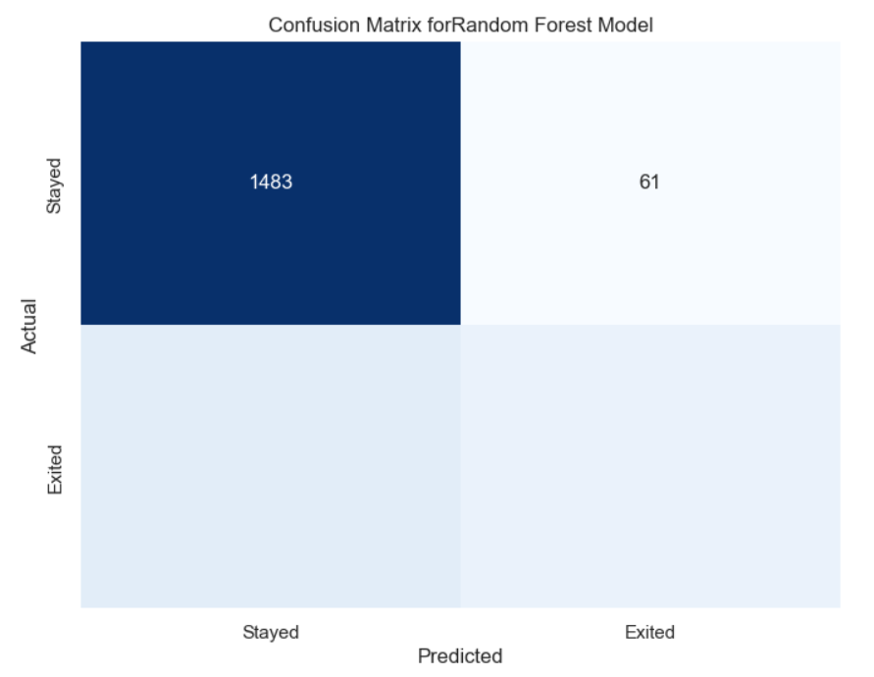
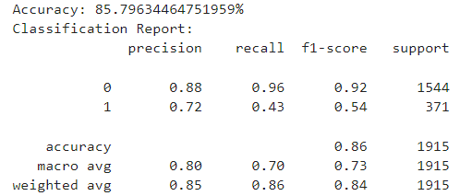
Optimisation
211
160

Slide 14
Conclusion
We can conclude that Model which best helps us to predict the Customer Churn is Random Forest with a good accuracy of 85%.
The bank can now use this model to identify high-risk customers and implement retention strategies.

Slide 15
Future Scope
Future Improvements could involve adding more features or use deep earning.

